Slide 1
Animating Sprites with CSS
By Phil Lindsay and Christine Largent

Slide 2
What you will need
Photo editor capable of making transparent backgrounds and cropping (Paintshop Pro, Photoshop, etc.)
Visual Studio Code or Notepad++
Web Browser (Chrome)
Demo code from GitHub
Sprite Sheets
Demo provides samples but spriters-resource.com is a great resource for additional sheets

Slide 3

Learning Objectives
Understand Sprites and Sprite Sheets
Identify CSS properties used to animate tagged HTML items
Demonstrate why the height and width of the tagged element is important in animating
Understand the role of the @keyframes tag in this context.

Slide 4
What are Sprites?
Small animation cells, usually in 8-16 bit formats.
Multiple Sprites in sequential order are called sprite sheets
Sprite animation happens by focusing on one cell at a time, over a period of time to create the animation. The concept is similar to that of a flipbook.

Slide 5



Sprite Sheets
Sprite sheets allow for animations to be made using one image containing each frame of the animation sequence.

Slide 6
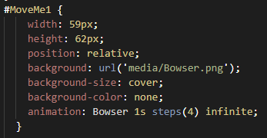
CSS Format
This is the HTML used to hold the animation on the web page
Example CSS:Attributes needed to edit
Width and Height are VERY important - if not correct the animation will distort
Both should be the same as each cell
Background is the Sprite Sheet image
Background size you want to set to cover to fit the space to the image
Background color should be set to none as we are using transparent backgrounds
That is why .PNG is the best format as it allows for transparency in backgrounds.

Slide 7
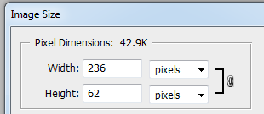

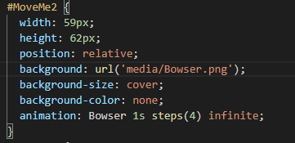
#MoveMe Height & Width Explained
Bowser Example
Width is equal (or close) the width of the cell multiplied by the steps (number of cells)
In this example the width is 236 px / 4 cells, so width = 59 px
Height is 62 px tall
When looking at the #MoveMe html that holds the bowser animation you’ll find:

Slide 8

@KeyFrames Explained
The animation property is set to the @keyframes, the duration of the animation, how many sprites used to create animation, and then the repetition of the animation.
The @keyframes tag tell the CSS how wide the sprite sheet is
This is how it knows where the sheet/animation ends
Note in this example the 236 px matches the bowser sheet width
It uses the steps from the animation tag to focus the width of the cell however many times for the steps across the entire width of the sheet.

Slide 9
So Why Not Use A Gif?
Control
Gifs have no start/stop
Independent Instances
Gifs move at the same time
Smooth Animation
Gifs don’t pre-load
Gifs Don’t Scale
File size to image size doesn’t scale well
https://stackoverflow.com/questions/10186257/why-not-animated-gif-instead-of-animated-css-sprites

Slide 10
How To Format Your Sprite Sheet
Once you select your sprite sheet to animate, identify the portion you want to animate
Using your selected photo editor cut out the cell frames desired
Paste those cells into a new image with a transparent background and erase all background color behind the cells
Make sure each cell is evenly set
Record the cell width for html tag
Record the cell height for html tag
Record overall sprite sheet width for @keyframes code

Slide 11
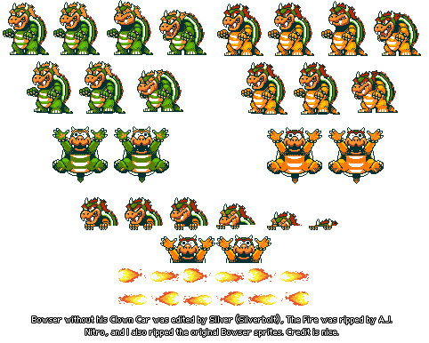
The sprite sheet goes from something like this...

Slide 12
To this...

Slide 13
Demonstration
https://github.com/NMCPLindsay/Spritesheets
Contains example of how the animations should look when completed -Demo.html
Do It Yourself
Download the starter code to practice.
https://github.com/NMCPLindsay/Spritesheets
Using preloaded sprite sheets in the Starter.html add animations
Readme.txt file shows image sizes

Slide 14
Take the Assessment
Notes:
https://docs.google.com/forms/d/e/1FAIpQLScz_7Nj1lqURRLPU_Rb2U45-oSMwDJEzwSDgMr9z4aFxRRX6w/viewform

